Slide 1
Fast Phrase Search for Encrypted Cloud Storage.
DEVANAPALLY SAI KRISHNA
CSCI 59000 Term PROJECT PRESENTATION

Slide 2
Overview:
Cloud Computing, the current trend in terms of data storage and data retrieval remotely. When it comes to challenges in cloud computing same thing that is, storage and retrieval are on the top priority. Less efforts have been done on specialized searching techniques. Here we propose a search technique using blooms filter with a series of n-filters which can significantly increase the search accuracy, with a similar or better storage and communication cost. In this search technique the tradeoff is between storage and false positive rate. This technique is also good against inclusion-relation attacks

Slide 3

Proposed system:
Current system mainly works on conjunctive word search which is not efficient when it comes to communication costs and other techniques have a chance to show other data also.
Here we attach a bloom filter along with the data uploaded from the data owner side. This reduces the search time for the key word.
This kind of system is good against intrusion attacks and scalable.

Slide 4
Previous Works:
1. D. Boneh, G. D. Crescenzo, R. Ostrovsky, and G. Persiano, “Public key encryption with keyword search,” in In proceedings of Eurocrypt, 2004
Solved the basic privacy issue caused due to searching.
Their scheme uses public key encryption to allow keywords to be searchable without revealing data content.
Identify urgent emails based on set of predefined words which are searched during runtime.

Slide 5
CONT.
2. B. Waters, D. Balfanz, G. Durfee, and D. K. Smetters, “Building an encrypted and searchable audit log,” in Network and Distributed System Security Symposium, 2004
Searching over encrypted audit logs by using a escrow to authorize the audio logs
Upload the data with public key encryption and receiver can user the key to decrypt and search for the data
Disadvantage of this is, receiver can see the search criteria.

Slide 6
CONT.
3. S. Zittrower and C. C. Zou, “Encrypted phrase searching in the cloud,” in IEEE Global Communications Conference, 2012
Conjunctive keyword search and phrase search is that the queried keywords must appear contiguously in the specified order in addition to all being present in the document.
His solution uses a keyword-to-document index and a keyword location index. The keyword-to-document index provides the mapping of keywords to the documents which contain them while the location index contains the position of the keywords within each document.
Data stored on client so more communication costs and more storage

Slide 7



Technologies Used:
Java Development Kit 8
Apache Tomcat 9
Mysql server 5.1
Eclipse oxygen
HeidiSQL 3.2

Slide 8
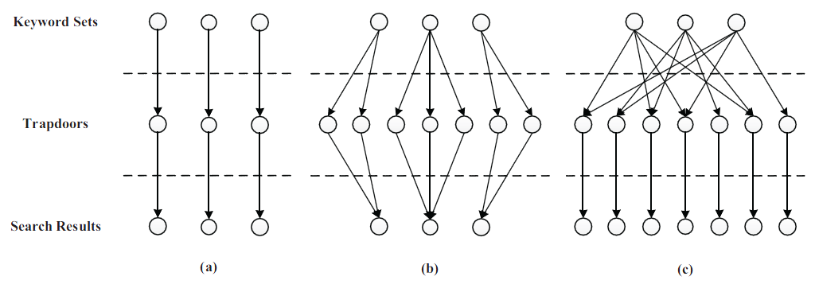
Blooms Filter
Bloom filter is used for conjunctive keyword search to reduce storage cost and provide security in the form of false positives.
Main advantage is, it address the problems with data storage.

Slide 9
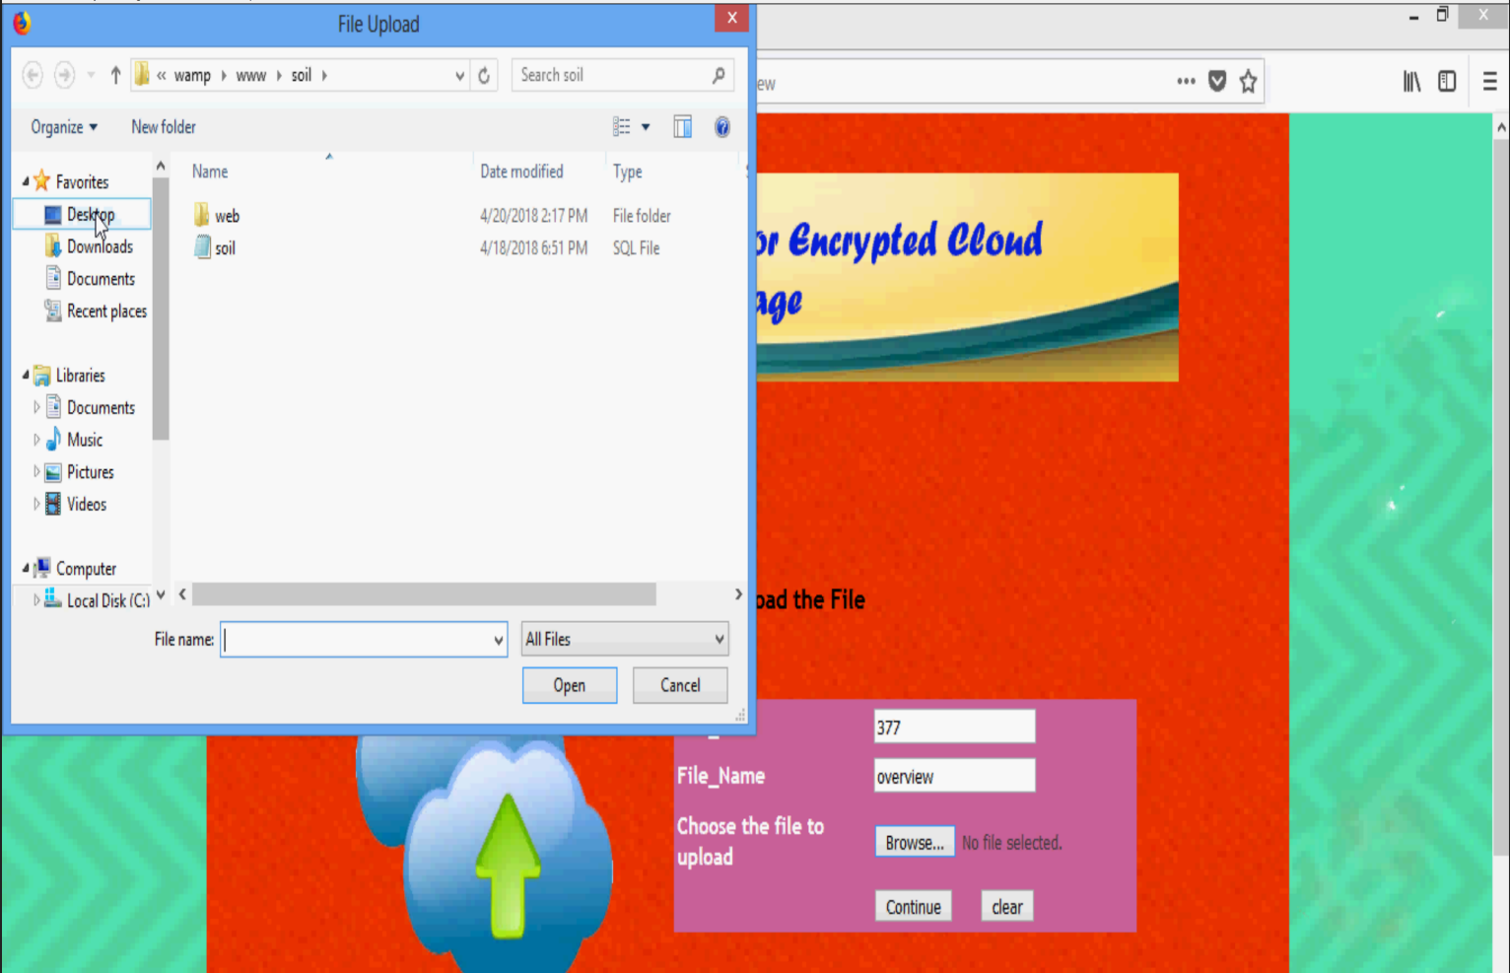
Flow of data
Data upload:
Data owner generates encryption keys and parses to keywords
Bloom Filter is attached to the data
Data is encrypted and uploaded to cloud(Server)

Slide 10
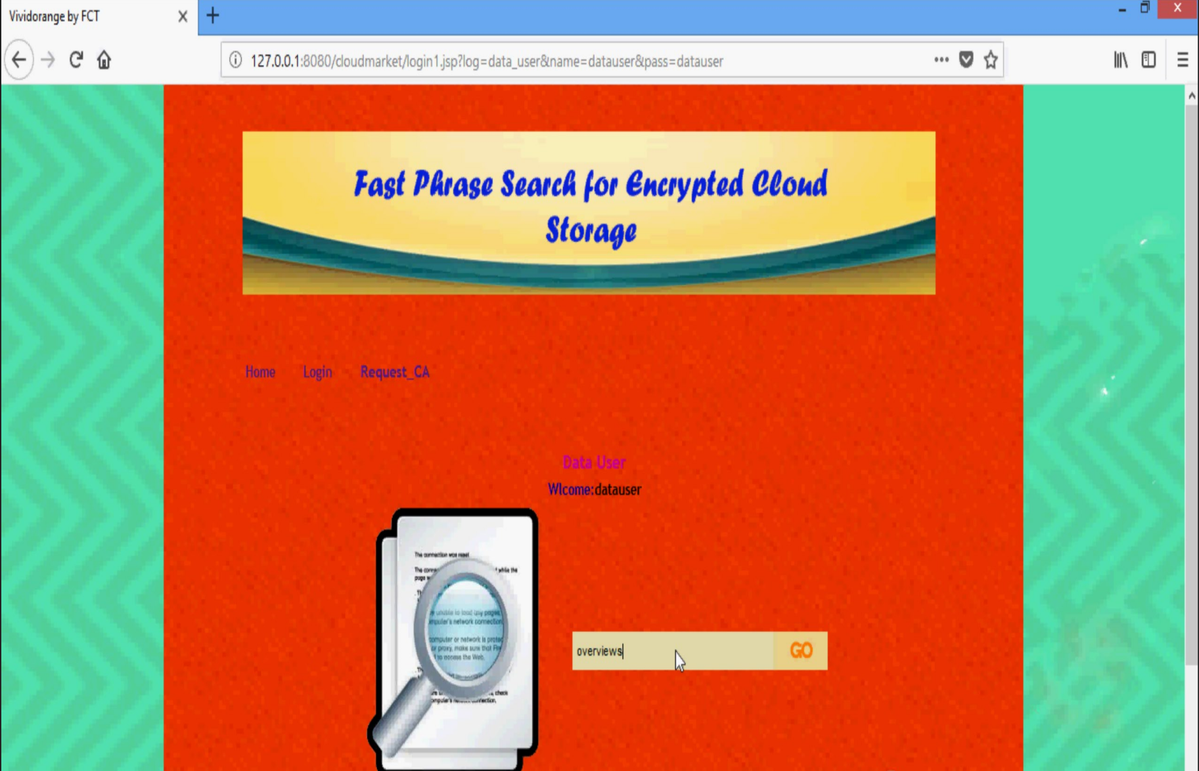
CONT.
To Search:
Data owner sends a trapdoor function of search word to initiate search
Cloud responds with the identifier of the record details
Returned results only contain meta data about the search word to increase the privacy features.

Slide 11
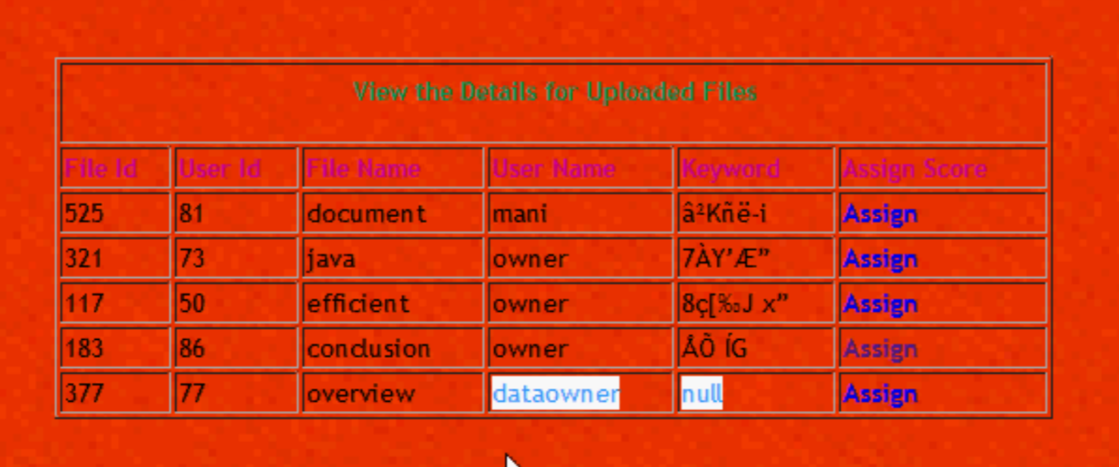
CONT.
To Delete:
Data owner requests cloud server to remover the file.
It is a one way communication.

Slide 12
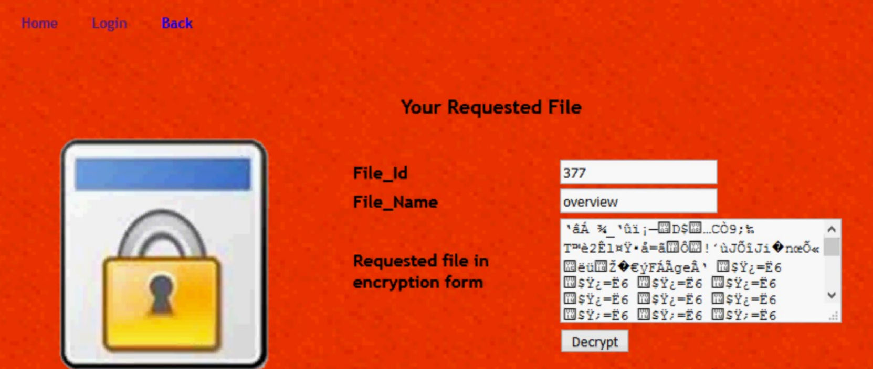
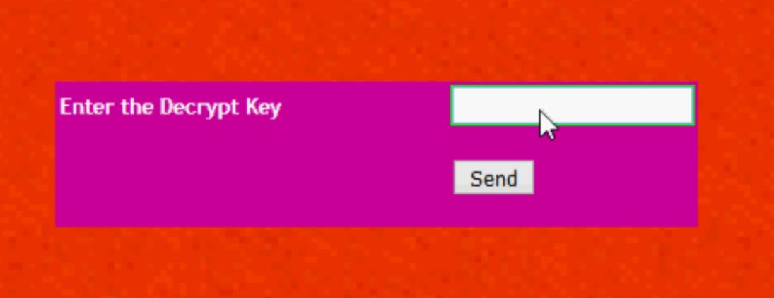
Fig 1
Fig 2
1.Data user needs to enter Decrypting key to access the file.
2.Showing a sample encrypted file, before final decryption

Slide 13
Conclusion:
Scheme based on Bloom filter that is significantly faster than existing approaches, requiring only a single round of communication and Bloom filter verifications.
It also achieves a lower storage cost when compared to few techniques in market where a higher computational cost was exchanged in favor of lower storage.
Future work, planning to implement NLP libraries in place of key phrase.

